Slide 1
”User stories” for developping venctester 3.0*
*name subject to change

Slide 2
Outline or something pretending to be an outline kinda in priority order
Good documentation
Compare performance of different versions of Kvazaar (when implementing new stuff)
For optimizations that shouldn't change the bitstream check that the bitstream is really not changed
Compare performance of different settings of specific Kvazaar version
Compare Kvazaar and x265, other encoders
Different presets
Rate control, static qp
Compare HM and VTM
Different configurations
Take account subsample ratio for AI
Automated weekly tests
Programatically generate new test cases
Graphical comparison: RD-curves
Result tables
Set compared encoder individually for each test case
Preset exploration and generation
Compare results from multiple input files
Check variance of rate control
Multipass encoding
Distribute tests across multiple machines

Slide 3
Glossary
Test: A single encoding run of one sequence with a configuration with all selected values of a quality parameter
Result: All of the measurements from one encoding
Report: The final output; csvs, plotted RD-curves, or summary table
Encoder: E.g. Kvazaar, x265
Encoder binary: A binary blob that takes raw video as input and encodes the video according to the input parameters and outputs an encoding
Encoding: An intermediate result that is just the encoded video, used for calculating the metrics
Test configuration: A combination of one encoder binary, one set of parameters, and sequences
Test suite: A collection of all of the test configurations
PSNR, SSIM: Quality metrics, calculated by FFMPEG from the decoded output and the raw input video
VMAF: Quality metric by Netflix
BD-Rate:
BSQ-Rate:
Constant QP vs rate control:
Preset: A default set of parameters for an encoder, different for each encoder, usually named from ultrafast to veryslow/placebo

Slide 4
Goals of Venctester 3
Powerful testing toolkit for encoder comparison and benchmarking
Fair and accurate comparison
Avoid mistakes of previous versions
Venctester 1: Convoluted frontend, everybody just added a new function when they needed output in some other format
Venctester 2: Dictionary of dictionary of dictionary of dictionary, generating tests was very difficult programmatically
Easy to change what is benchmarked or compared
Clear presentation of measurement results
Easy to understand which encoder is the best and if the results are % or not
A document which describes all the ways of usage
Easily extensible

Slide 5
Tester Process Diagram
Can be combined
Do not store temp files, pipe to next process
(optional)
Warmup round for each input to be cached
FFMpeg or encoder specific decoder
FFMpeg or external tool
Input
(YUV files + DQP maps + …)
Encode one QP/Bitrate
Decode
Calculate metric(s) against input
Generate output graphs etc
Output
(encoded files + logs + metric logs + graphs)
For each QP / Bitrate / .. (usually, but not always, 4x per seq)
By default first run all encoding -> decode -> metrics -> remove unneeded files (configurable)
Extra info
Tester process
Parallel execution (configurable number of threads)
Calculate metrics requiring multiple inputs (BD-rate..)

Slide 6
Compare different versions of Kvazaar
Start by checking the given parameters to prevent random crashes after several hours due some typo
Check that the order of the parameters makes sense, i.e., setting the preset does not override some other setting
Check if the results exist or a results for a command line that evaluates to the same parameters exists already
Unless rerun is forced
Automatically build the encoder binaries (unless prebuilt binary is specified)
Trivial smoke testing functionality (similar to CI)

Slide 7
Compare performance of different settings of specific Kvazaar version
Compare
Different presets
Constant QP vs rate control (encode first with constant QP and use the resulting bit rates for rate control)
One or more parameters
User can set anchor individually for each test configuration
User can set multiple anchors for any test configuration

Slide 8
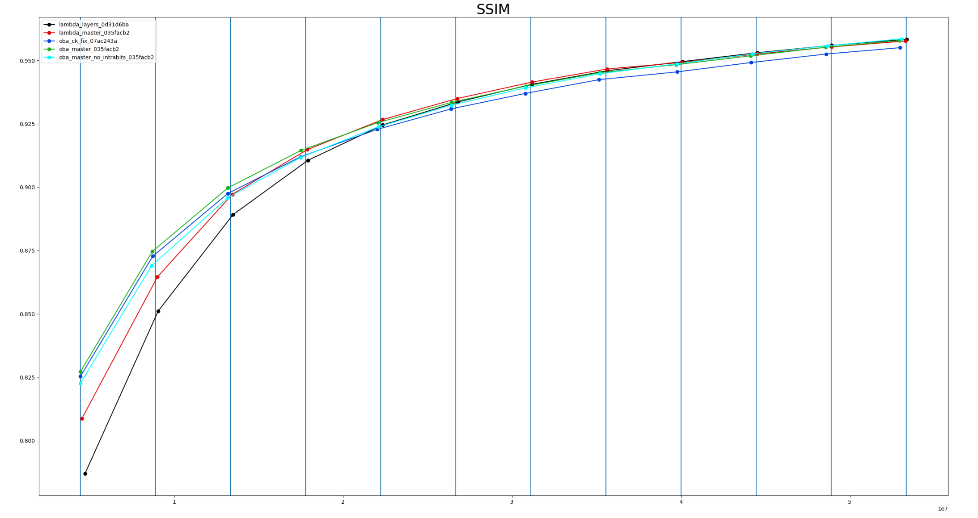
Compare Kvazaar and x265
Select sequences used for test
Select version for each encoder and the frame work builds the encoder binary automatically
Set and adjust preset for each encoder
Before each encoding it is made sure that the encoder and sequence are cached into the RAM by OS (warmup)
Output csv of BD-Rates (and BSQ-Rate) for PSNR and SSIM, summary table, and rd-curves for each sequence
And many many more statistics...
Log all the build and test processes to files
Rate-Distortion(RD) -curve

Slide 9
Compare HM and VTM
Select the configuration under which the encoders are compared (Random access, low-delay, intra...)
If selecting intra VTM and if subsampling is set in configuration file, encodes only every eight (number may change over time) frame and HM should match it
Mainly impacts to the number of overall frames and calculating results
Select test sequences and QPs
Select bit depth and number of frames to encode for each sequences
Set intra frame period separately for each sequence
Select anchor
Configure how many encoder instances are ran at the same time
User may select to keep the encodings and result files (such as encoding and decoding logs, ffmpeg logs etc.)
If the results already exist, provide the results
If the final results don’t exist, encode the videos and calculate the Bjontegaard-delta bitrates (PSNR, SSIM, VMAF) for each sequence
Output of progress (during the process, error state, number of sequences etc.)
Be prepared for failures because insufficient system memory compared to amount of parallel encodings

Slide 10
Automated weekly tests (external)
Test suite run at the specific time on the specified days (cronjobs)
The newest 'master' of Kvazaar is fetched, built, and used for tests
The server reservation status is checked
If free, reservation is made, and weekly tests will run
If reserved, tests will not run
PDF summary table is generated and uploaded to HTTP-server
Reports BD-BR(s) and speedups for each tested Kvazaar presets and sequence
Anchors may be for example
Earlier version of Kvazaar with respective presets
Fixed version of x265 with respective presets

Slide 11
Programmatically generate test cases
For example:
tests = []
for commit in [“Master”, “Experimental”]:
for preset in [“ultrafast”, “veryslow”]:
for option in [“exp-opt”, “no-exp-opt”]:
tests.append(…)
run(tests)

Slide 12
Preset generation and exploration
Generate optimal presets with the given constraints
The slowest preset is fixed as the anchor
Some semi-intelligent search for preset candidates
Selecting presets from candidates
Best RD with evenly spaced points on the complexity axis
For preset tables, from ~real-time to ~1 fps (anchor)
Or Best RD for given encoding speed

Slide 13
Compare results from multiple input files
Compare encodings with same parameters but different modifier files
For example, an external deltaQP-map file can be used to modify the encoder process
Tests with different sets of external files should be treated as tests with different parameters so they can be compared against test configurations which used a different set of external files
Ability to map which external file in the set is to be used with which test sequence
Could also be automatic, ex. external file with same base name is used with test sequence with said basename
Check that all required external files are present before starting

Slide 14
Report variance / Multiple runs
Encoding time is not constant, set the amount of times each encoding is run
Report the average encoding time and standard deviation
In general the output bit stream should be deterministic, allow testing if this is true
With rate control the output is not deterministic, report the average bit rate and quality and standard deviation of the two

Slide 15
Multipass encoding
At least x265 supports encoding where encodings gather data and refine the encoded output on each subjacent run based on the data gathered.
Support for this
Also Kvazaar may in the future support multipass encoding, so the framework should be easily modifiable to support it

Slide 16
Distribute tasks
Allow running the tests on multiple machines (in the future)
Particularly VTM and to a lesser extend HM encoding take a very long time so in some cases it might be necessary to run the tests on multiple machines

Slide 17
Error handling
Running out of storage: fail gracefully, informative output
Running out of RAM because of too many parallel encodings: Decrease the amount of parallel tasks and rerun the failed tasks. This will happen practically only with HM and VTM in which case you want to terminate the test suite as soon as possible and start again with fewer parallel tasks
Typo in parameters: Fail early and report
Glob extends to zero files: Fail early and report which glob didn’t produce any files
Building an encoder fails: Report clearly and run properly build test configuration normally if build count >= 2
Fetching the commit fails: ^
Non monotonic RD-curve when BD-rate is needed: indicate in the report but otherwise generate report normally
Non-overlapping RD-curves: indicate in the report different way to ^ but otherwise generate report normally
Environment is not set up correctly: Test that all needed binaries e.g. are found at the beginning and then fail gracefully if not found
Decoding fails: do not include in report but continue normally and indicate the failed decoding(s) in the error log
Hash mismatches in decoding: Abort after x occurrence, indicate in the error log
Encoder crashes mid encoding: Abort after x occurrence, indicate in the error log, don’t calculate results and don’t include in report
Multiple test configuration with same name: Fail early

Slide 18
Output
CSV:
Create directory structure if user wants it in non-existing directory
Configurable whether each encoding run has its own line of only averages
Mandatory fields:
name of encoder binary / user given name
Parameters
Quality parameter
Value of quality parameter
Anchor
Sequence
Sequence class
Set of external files (only when external files are used)
Configurable optional fields:
PSNR
PSNR-BDBR
SSIM
SSIM-BDBR
VMAF
VMAF-BDBR
Speedup
Average of absolute encoding time
Std dev for PSNR, SSIM, VMAF, Speedup
Number of runs
Bit count
RD-Curves:
One figure for each sequence
Place in a user given folder, create it if doesn’t exist
Include legend with name of encoder binary / user given name for each curve

Slide 19
Logging
In addition to encoding and decoding logs write a high level summary log
Generate build logs when an encoder is build
Summary log should contain items for the following events:
High level entry for when a set of tests begins and finishes
Specify the test case in which the failure occured (aka sequence, QP, etc.)
Start / finish times for single tests?
In case of errors, it should be easy to find when and with which sequence the error happened

Slide 20
Workflow recommendations
Test each user story after it is completed
Try to get a minimum viable product working as soon as possible and give it for others to use during Venctester development
MVP: Define two Kvazaar binaries and potentially different set of parameters for each and generate a csv-report for these two test configurations

